Slide 1
Spotify Playlist Audio Analysis
Presented for
SMU Data Science Bootcamp 2018-2019
By
Christopher Sicking, Erik Swedeen, Justin Schlankey, Shashi Pathak
January 19, 2019

Slide 2
Outline
Introduction
Procedure
Data Visualization
Conclusion

Slide 3
Introduction
What did we want answered?
How can we predict that a song will be popular for a certain genre?
What did we expect?
Certain audio profiles are indicative of song popularity within a particular genre.
Why did we choose Spotify?
There is a large amount of available data
Intuitive audio analysis properties included

Slide 4

Outline
Introduction
Procedure
Data Visualization
Conclusion

Slide 5
Procedure
Select Popular Playlist
Get Track List for Playlist
Get Audio Properties for Each Track
Determine Optimal Value for Each Property
Determine Between Audio Properties

Slide 6
Code Build
Libraries
Spotipy, Pandas, Numpy, Matplotlib, Scipy.stats
API Calls (Utilizing the Spotipy Library)
User_Playlist_Data
User_Playlist_Tracks
Track_Audio_Features
DataFrame
Audio Features (Properties)
Data Visualization
Normal Distribution
Matplotlib, Scipy.stats, Numpy

Slide 7

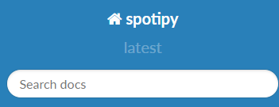
Code Build: Libraries
Libraries
Spotipy – acquire specific music data from Spotify
Pandas – sort out the data into tangible fields
Numpy - calculate the mean of various track features
Matplotlib – show the data in different graph types

Slide 8
Code Build: Spotify APIs
Spotify API Call overview:
User_Playlist_Data
User_Playlist_Tracks
Track_Audio_Features

Slide 9
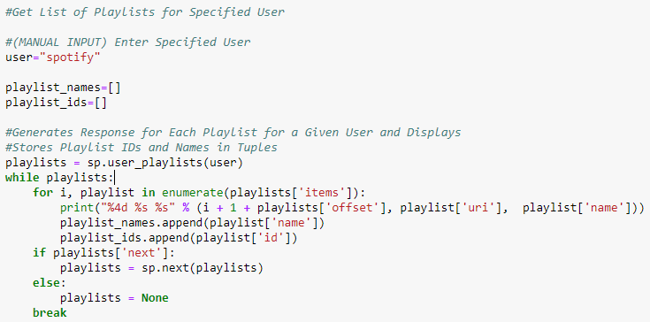
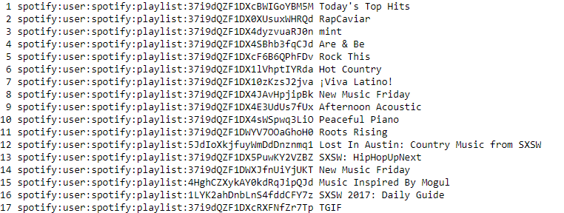
Spotify API: User_Playlist_Data
User=“spotify”

Slide 10
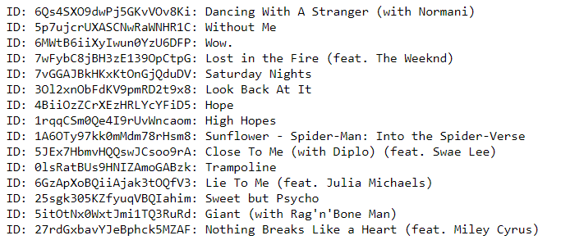
Spotify API: User_Playlist_Tracks
After gathering the names of the playlists and their data, we are now able to pull the names for each of the tracks.
# Create lists to store song ID's and song names
song_ids = []
song_names = []
for i in range(len(playlist1["items"])):
song_id = playlist1["items"][i]["track"]["id"]
song_name = playlist1["items"][i]["track"]["name"]
song_ids.append(song_id)
song_names.append(song_name)

Slide 11
Spotify API: Track_Audio_Features
With the playlist track data, we can then pull each features and place their values into lists, which we can then place into a data frame.
# Loop though list of song ID's
for track in song_ids:
track_features = sp.audio_features(tracks = track)
# Append audio features to respective lists
danceability.append(track_features[0]["danceability"])
energy.append(track_features[0]["energy"])
speechiness.append(track_features[0]["speechiness"])
acousticness.append(track_features[0]["acousticness"])
tempo.append(track_features[0]["tempo"])
instrumentalness.append(track_features[0]["instrumentalness"])
liveness.append(track_features[0]["liveness"])
loudness.append(track_features[0]["loudness"])

Slide 12
Spotify API: Track features definition
The track features information helps us determine different aspects of each song to analyze and compare against. The amount of comparisons is limitless and each feature offers a different perspective for each track.
Danceability – A value of 0.0 is least danceable and 1.0 is most danceable.
Energy – Energy is a measure from 0.0 to 1.0 , perceptual measure of intensity and activity.
Speechiness – Values below 0.33 most likely represent music and other non-speech-like tracks.
Acousticness – A confidence measure from 0.0 to 1.0 of whether the track is acoustic. 1.0 represents high confidence the track is acoustic.
Tempo – The overall estimated tempo of a track in beats per minute (BPM).
Instrumentalness – The closer the instrumentalness value is to 1.0 the greater likelihood the track contains no vocal content.
Liveness – Higher liveness values represent an increased probability that the track was performed live.
Loudness - Loudness values are averaged across the entire track and are useful for comparing relative loudness of tracks.
Valence – A measure from 0.0 to 1.0 describing the musical positiveness conveyed by a track.

Slide 13
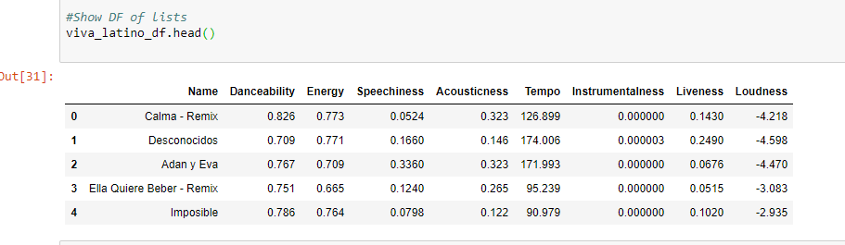
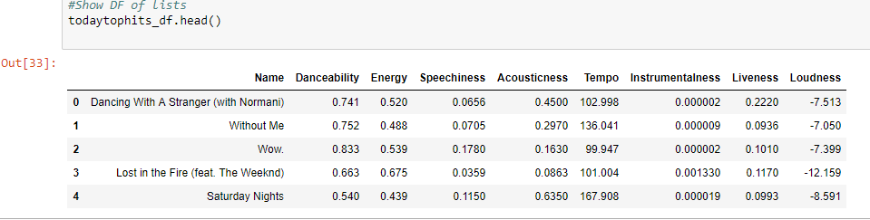
Code Build: Audio Features DataFrame

Slide 14
Outline
Introduction
Procedure
Data Visualization
Conclusion

Slide 15
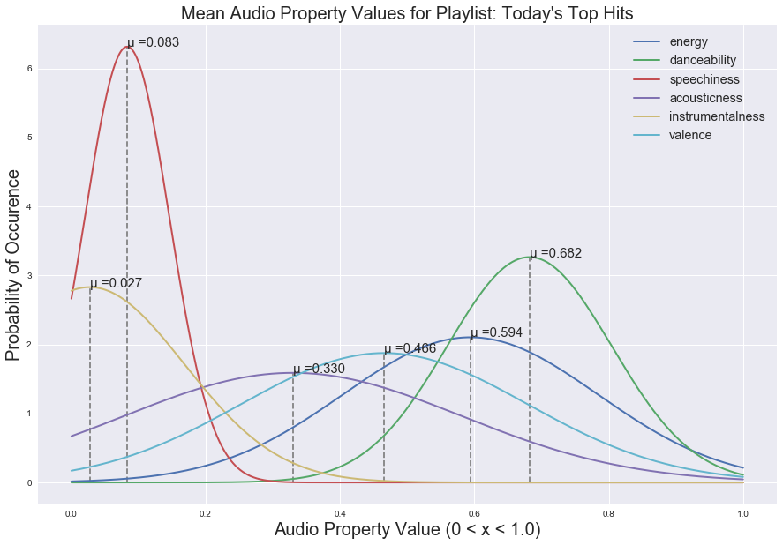
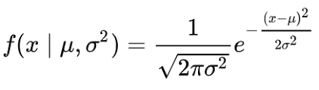
Data Visualization
Normal Distributions for Each Audio Property
Probability Density Function

Slide 16
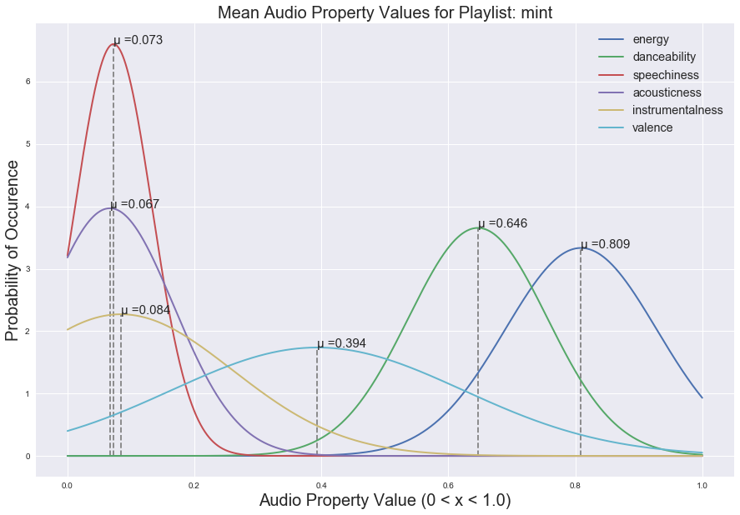
Data Visualization

Slide 17
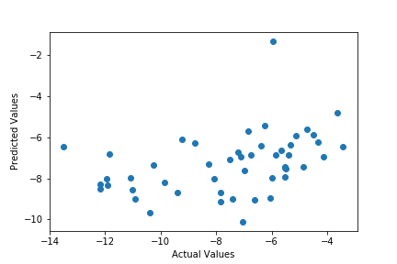
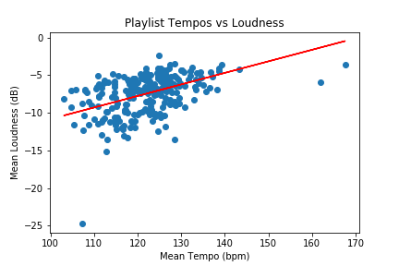
Data Visualization
Pearson Coefficient: 0.44465166483207086
P-value: 3.008706389211429e-13
Regression line: f(x) = (0.22842651)x - 26.1755577
P-value: 0.005180979606036537

Slide 18
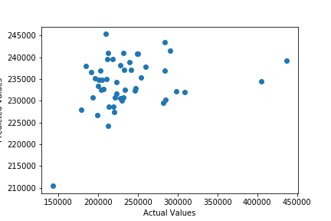
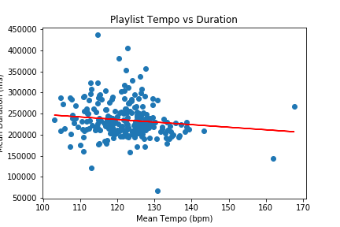
Data Visualization
Pearson Coefficient: -0.16529188855537577
P-value: 0.009695642604939199
Regression line: f(x) = (-608.96108)x + 309070.021
P-value: 0.04084565055027933

Slide 19
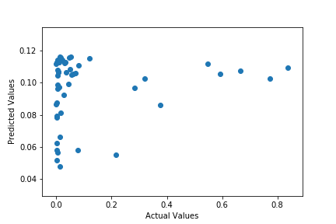
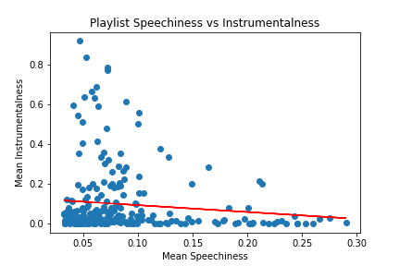
Data Visualization
Pearson Coefficient: -0.1264527879069382
P-value: 0.04849102564409151
Regression line: f(x) = (-0.3458388)x + 0.12766523
P-value: 0.2929737495747323

Slide 20
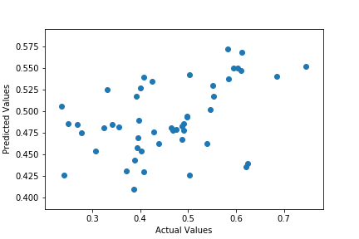
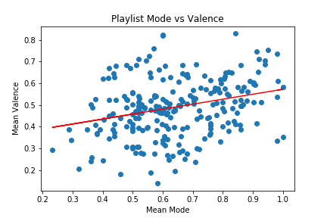
Data Visualization
Pearson Coefficient: 0.30047854404435975
P-value: 1.7490137431591394e-06
Regression line: f(x) = (0.2284265)x + 0.34428786
P-value: 0.0017059718884043103

Slide 21
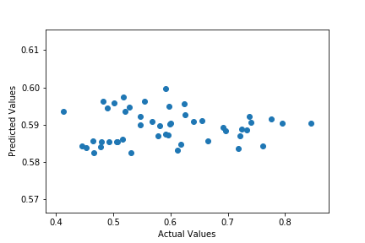
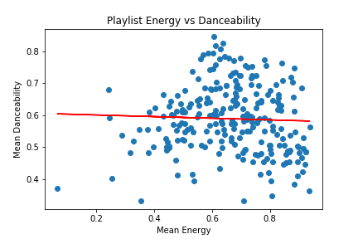
Data Visualization
Pearson Coefficient: -0.03731902464076776
P-value: 0.561813132636831
Regression line: f(x) = (-0.02564602)x + 0.6059237
P-value: 0.8334092067392466

Slide 22
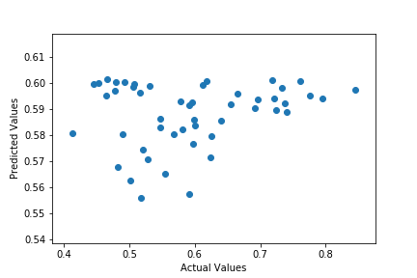
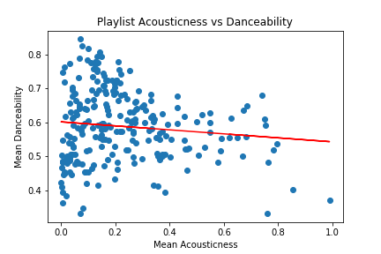
Data Visualization
Pearson Coefficient: -0.1272023574456582
P-value: 0.047163277736522624
Regression line: f(x) = (-0.05879148)x + 0.601805
P-value: 0.15935336005736278

Slide 23
Outline
Introduction
Procedure
Data Visualization
Conclusion

Slide 24
Conclusion
The linear regression model returned generally weak results. Simple linear regression shows that individual audio features don't correlate very strongly with each other. There’s more going on that a more complex regression could show.
Narrowing the Linear Regression Analysis to a more specific set of playlists based on genre should improve the results.

Slide 25
Comments
Additional Work to be Done, Etc…
Other Analyses or Considerations
Which tracks with what values have the most impact on the listener

Slide 26


Questions?

